Slide 1
Introduction to Simulation and Modeling
Azaz Ahmed Kiani

Slide 2
Input Data Collection and Analysis
(Lecture 15)

Slide 3
Introduction
In a simulation project, the ultimate use of input data is to drive the simulation.
This process involves the collection of input data, analysis of the input data, and use of the analysis of the input data in the simulation model.
The collection of input data is often considered the most difficult process involved in conducting a simulation modeling and analysis project.

Slide 4
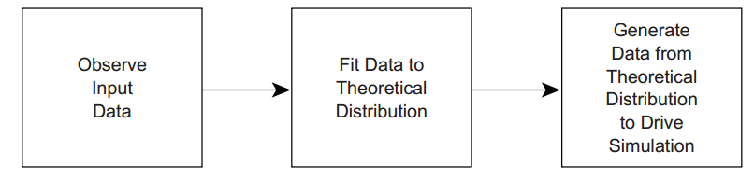
Introduction

Slide 5
Sources for Input Data
This data can be historical or observational.
Even if an actual system model does not exist, it is possible for the practitioner to acquire the needed input data from other sources.
Sources that are available to the practitioner include, but are not limited to, the following:
Historical records
• Manufacturer specifications
•Vendor claims
• Operator estimates
• Management estimates
• Automatic data capture
•Direct observation

Slide 6
Historical Records
If the base system or a similar base system has been in existence for some time, it is likely that some form of historical records is available to the practitioner.
However, the use of historical records is not without great risk.
The first risk is that the original historical system has changed somehow or is not exactly identical to the current or proposed system.
Another problem is that the historical data may not have been collected with a simulation model specifically in mind.
This means that the data that are really needed are not actually available.

Slide 7
Manufacturer Specifications
Most manufacturers will be providing a theoretically based specification for their equipment.
Whether or not these claims can actually be achieved in a real environment has to be proven.

Slide 8
Operator Estimates
Operators of existing equipment can be a valuable data resource when the practitioner does not have the time or data collection resources to collect actual data.
If the operator is knowledgeable about the system, it may be possible to obtain some performance estimates that can be used as input data.
For example, the operator could be questioned on the shortest, most common, and longest processing times for a particular operation.

Slide 9
Management Estimates
The practitioner may also consider soliciting managers or engineers associated with the system.
Though these individuals probably do not have the same proximity relationship to the process, their input may be helpful when an experienced operator is not available for input.

Slide 10
Direct Observation
This is where the practitioner or another individual actually goes to the location of the system and visually collects data.
The data are collected by pen and pad or perhaps with some technological assistance.
If the low-tech pen-and-pad approach is used, the practitioner may want to develop some sort of data collection form to keep the process as organized as possible.
An example of the headings on this sort of form for a customer-based system is provided below:

Slide 11
Direct Observation

Slide 12
Collecting Input Data

Slide 13
Data Collection Devices
If input data are collected in real time, it may be collected either manually or with the assistance of electronic devices.
The analyst may choose to develop a simple program on a notebook computer to assist with the collection of data.
The use of video recording devices offers yet another possibility for collecting data when privacy issues do not need to be considered.

Slide 14
Time Collection Mode and Units
An important issue for simulation input data concerning time intervals is the time unit that should be used.
Novice practitioners can be frequently observed recording the absolute time or clock time of when different entities arrive into the system.
A second time collection issue is what types of units to use. For calculation purposes, it may be difficult to use as small a time unit as seconds.
It is more easily understood when a simulation run is performed for either 8 h or 480 min, not 28,800 s.

Slide 15
Time Collection Mode and Units
all of the data values would either have to be collected in the same time unit or converted at some point.
It is also possible to acquire what is known as a decimal minute stopwatch.
This type of special stopwatch records minutes as minutes and seconds as hundredths of minutes.
When a decimal stop watch is used, the data are collected in an immediately usable format

Slide 16
Other Data Collection Considerations
There are at least two reasons for this:
1. You want unbiased data.
2. You do not want to disrupt the process.

Slide 17
Deterministic versus Probabilistic Data
Deterministic data mean that the event involving the data occurs in the same manner or in a predictable manner each time.
Examples of deterministic input processes include:
Preventive maintenance intervals
Conveyor velocities

Slide 18
Deterministic versus Probabilistic Data
Probabilistic process does not occur with the same type of regularity.
In this case, the process will follow some probabilistic distribution.
Examples of probabilistic data include:
Inter-arrival times
Customer service processes
Repair times

Slide 19
Deterministic versus Probabilistic Data
In addition, any time a human being is involved in a service process, there is likely to be some variance in the service times.

Slide 20
Discrete vs. Continuous Data
Discrete-type data can take only certain values. Usually this means a whole number.
Examples of discrete data in simulation applications would be:
The number of people who arrive in a system as a group or batch
The number of jobs processed before a machine experiences a breakdown

Slide 21
Discrete vs. Continuous Data
Continuous distributions, on the other hand, can take any value in the observed range.
Examples of continuous type data include:
Service times
Route times

Slide 22
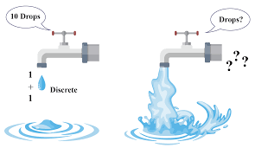
Discrete vs. Continuous Data

Slide 23
Summary
Any Questions?

